Slide 1
Wireless Networking CS4222/CS5222 Tutorial 6-Week 10
TA : Ayanga Kalupahana
(PhD student, SoC )
ayangaim@comp.nus.edu.sg

Slide 2
Today’s Plan
Discuss tutorial 6

Slide 3
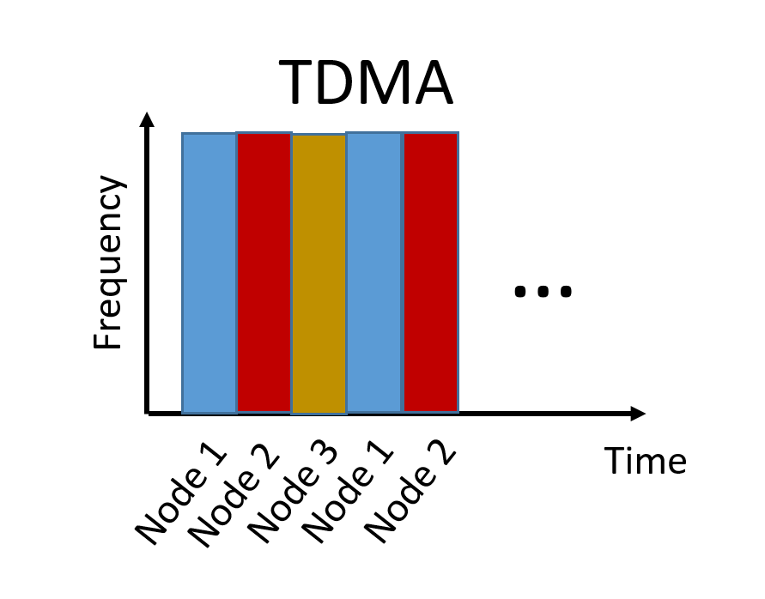


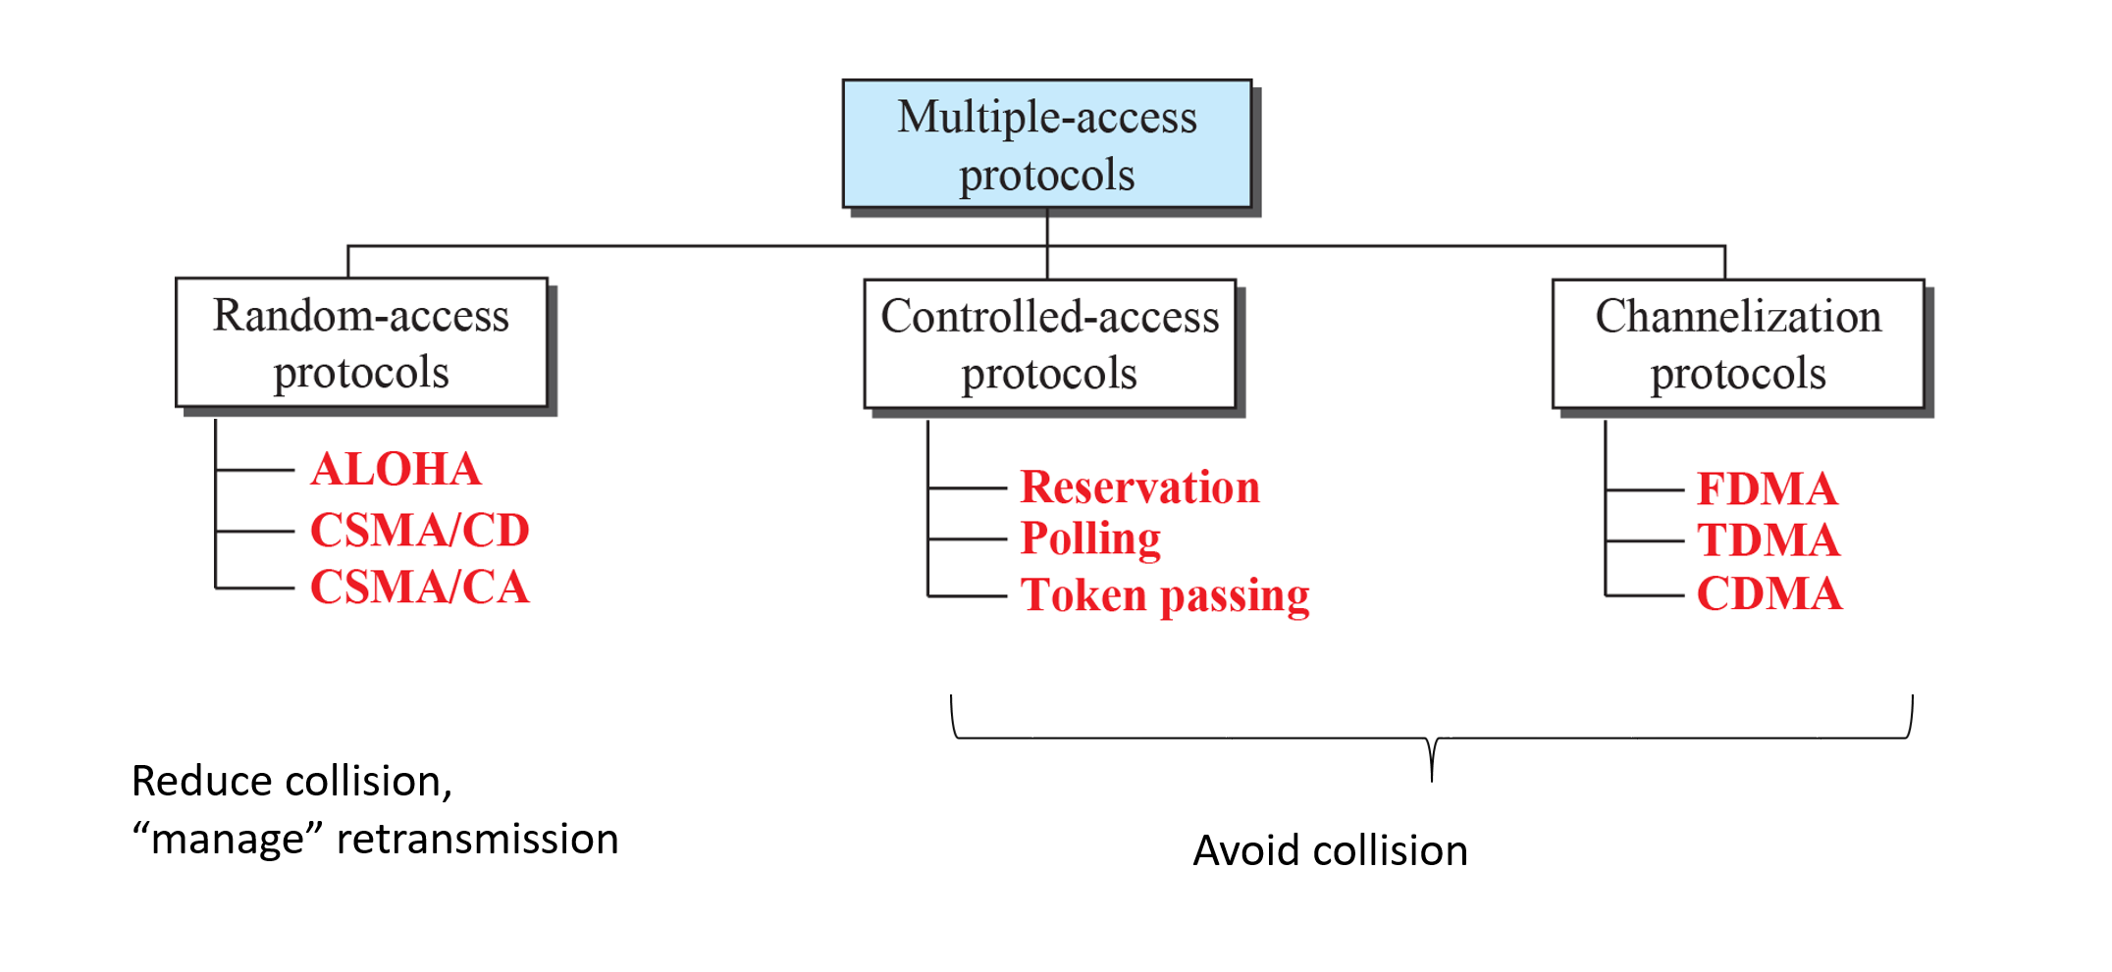
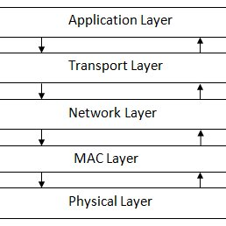
Question 1: Is TDMA a good choice for IEEE 802.11 (or WiFi)?
Wireless sensor network protocol stack

Slide 4
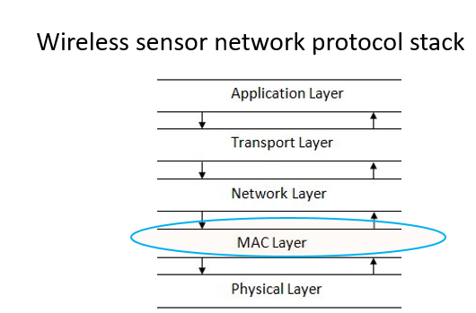
The choice of medium access control (MAC) protocol depends on several factors.
The most important ones are:
a) The characteristics of the dominant traffic type
b) The desired quality-of-service (QoS) for the traffic

Slide 5

Time division multiple access (TDMA) is a suitable MAC protocol for wireless traffic that is
continuous or constantly active
requires predictable latency
For example, TDMA can be good for applications that involve voice communication.

Slide 6

Most Wi-Fi devices want
To transmit large amounts of data at high throughput
Not very sensitive to latency
Present many end-devices in a Wi-Fi network, but only a few may be active at any given time.
Wi-Fi devices should be able to join and leave the network easily.
Considering all of the above factors, it makes TDMA a poor choice for IEEE 802.11 or Wi-Fi.

Slide 7
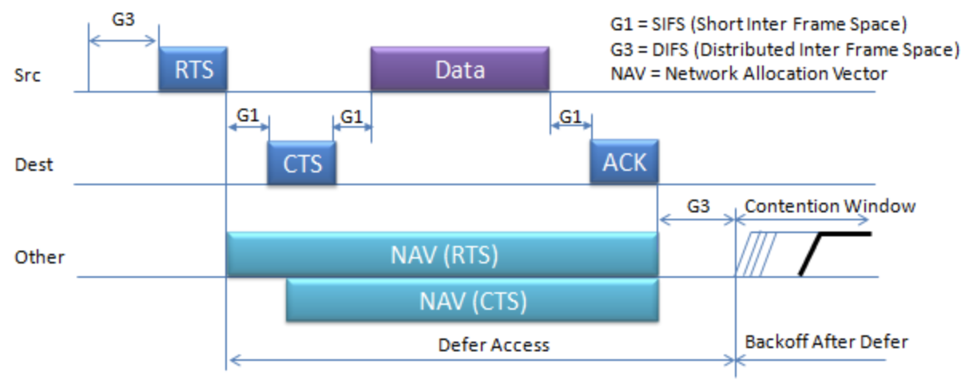
Question 1: Is TDMA a good choice for IEEE 802.11 (or WiFi)?
TDMA
CSMA/CA
…
Frequency
VS
Time
Node 2
Node 1
Node 1
Node 3
Node 2
Predictable latency – suited for low-latency applications
Suitable when there’s continuous traffic from multiple nodes
Can achieve high throughput when not all users are simultaneously transmitting
Suitable when there are many nodes but only few transmit at a time

Slide 8
Question 2:
Four 802.11 stations share a single channel. The four stations have different link rates, namely 2Mbps, 20Mbps, 50Mbps and 100Mbps. The standard 802.11 CSMA/CA MAC protocol with BEB is used.
What is the average throughput if all four stations always have packets to transmit?
Let us assume that the time required to transmit one packet at a data rate of 2 Mbps is one time unit.
Since all the stations have one packet to transmit, we can calculate the total time needed to transmit four packets as follows:
Total time = 1 + 1/10 + 1/25 + 1/50 = 1.16 time units
Notes:
Binary Exponential Backoff (BEB) refers to a collision resolution mechanism used in random access MAC protocols. This algorithm is used in Ethernet (IEEE 802.3) wired LANs. In Ethernet networks, this algorithm is commonly used to schedule retransmissions after collisions.

Slide 9
What is the average throughput if all four stations always have packets to transmit?
To find the normalized transmission rate (with respect to 2 Mbps), we divide the number of packets by the total time:
Normalized transmission rate = 4 / 1.16 = 3.448 packets per time unit
Finally, we can multiply the normalized transmission rate by the data rate to get the average throughput:
Average throughput = 2 * 3.448 = 6.897 Mbps

Slide 10
What is the average throughput if the protocol used (not CSMA/CA) ensure that all stations are given same amount of time to transmit?
This is similar to TDMA (time-division multiple access)
Hence, in one second, each node gets t =1/4 seconds to transmit
Total data sent due to Station 1 in one sec = (1/4) x 2 = ½ Mbps
Total data sent due to Station 2 in one sec = (1/4) x 20 = 5 Mbps
Total data sent due to Station 3 in one sec = (1/4) x 50 = 12.5 Mbps
Total data sent due to Station 4 in one sec = (1/4) x 100 = 25 Mbps
Total throughput = 43 Mbps

Slide 11
Question 3:
5 nodes (A, B, C, D and E) forms a straight line. The distance between the nodes are such that neighbouring can communicate but transmissions from nodes further away cannot be received. For example, A and B can communicate, but A and C cannot. Similarly, C and D can communicate, but B and D cannot. The nodes perform carrier sensing follow by RTS/CTS before data is transmitted.
A
B
C
D
E
A
B
C
D
E
Notes:
RTS/CTS : Request to Send/ Clear to Send

Slide 12
If node A is transmitting to node B, which other pair(s) of nodes can communicate at the same time?
A
B
C
D
E
A
B
C
D
E
Stations that hear RTS / CTS will mark the medium as busy, and hence seize to receive or transmit for that duration.
Hence only D ⬅➔ E is possible

Slide 13
If node B is transmitting to node C, which other pair(s) of nodes can communicate at the same time?
A
B
C
D
E
A
B
C
D
E
Stations that hear RTS / CTS will mark the medium as busy, and hence seize to receive or transmit for that duration.
Hence no other pair of nodes can communicate

Slide 14
Assume that node A is sending data to station E through nodes B, C, and D. All transmissions rates are 11Mbps and RTS/CTS is used. What is maximum throughput achievable? Explain your answer.
A
B
C
D
E
Frame 1
Frame 1
Frame 1
Frame 2
Frame 1
Frame 2
Packet received once
every three slots
Throughput
= 11/3 Mbps
Frame 2
Frame 3
Frame 2
Frame 3
Frame 3
Frame 3
time

Slide 15
Question 4:
Two mobile nodes (A and B) communicate using B‐MAC. By default, a node performs preamble sampling every 1s for a 1ms interval. In addition, node A wakes up every 100s and sends a small packet to mote B. Assume that each node is equipped with a battery with life time of 2300mAh. Transmission draws 20mA and receiving or idle listening draws a current of 10mA. You can assume that processing and sleeping do not consume energy.
How long can node A run before the battery is completely depleted?
1e-3 sec
Idle Listening
Transmitting
…
Node A
1 sec
Preamble
Data
~ 1 sec
Notes:
preamble sampling protocols :where all the nodes wake-up asynchronously, sniff for the activity in the medium and go back to sleep.

Slide 16
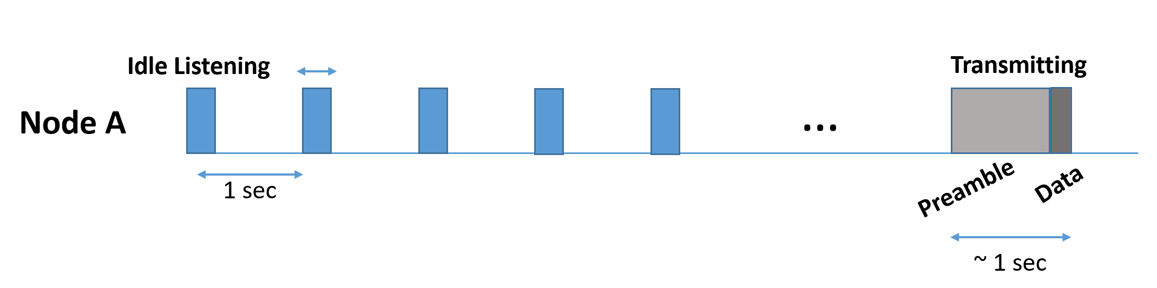
How long can node A run before the battery is completely depleted?
The current of 1A means there is 1 coulomb of charge passing through a cross-section of a wire every 1 second
TX ➔ 20mA and RX / idle listening ➔ 10mA
1e-3 sec
Total passing charge in 100s = 99 x 1e-3 x 10 + 1 x 1 x 20 = 20.99 C (Since we are using Q=It relationship )
Average current consumed (per sec) = Q/t = 0.2099 mA
Hence, battery life = Battery capacity / Average current
=2300 *60*60/ 0.21 seconds (Since 2300mAh needs to convert mAs)
= (2300 *60*60/ 0.21 )/60*60*24 days
= 456.35 days ( ~457 days)

Slide 17
How long can node B run before the battery is completely depleted?
TX ➔ 20mA and RX / idle listening ➔ 10mA
~ 1 sec
1 ms
Idle Listening
Receiving
…
Node B
1 sec
Preamble
Data
b/w ~0-1 sec
On avg, 0.5 seconds!
Total passing charge in 100s = 99 x 1e-3 x 10 + 1 x 0.5 x 10 = 5.99 C (Since we are using Q=It relationship )
Average current consumed (per sec) = Q/t= 0.0599 mA
Hence, battery life = Battery capacity / Average current
= 2300 *60*60/ 0.06 seconds (Since 2300mAh needs to convert mAs)
= (2300 *60*60/ 0.06 )/60*60*24*365 years
= 4.38 years

Slide 18
Consider the case where there is an additional node C and node A can transmit to either node B or node C (no change in A’s transmission rate). Will the lifetimes computed (in parts a and b) for nodes A and B change? Explain your answer.
Node A
Does not change its preamble duration / transmission interval
➔ No change in average current and battery duration
Node B
There is no modification to listening interval
But maybe modifications to receiving
➔ Very small decreases can be in average current and very small increases in battery durations

Slide 19
Question 5:
For each of the following applications, explain what is the most appropriate MAC protocol that should be used. Explain your choice.
Web browsing
VoIP
Low rate control traffic and carrier sensing is not performed.

Slide 20
Slide 43, Lecture 6
Notes:
Controlled access protocol :There is no collision since channel access is controlled by a central controller

Slide 21
For each of the following applications, explain what is the most appropriate MAC protocol that should be used. Explain your choice.
CSMA/CA
High throughput possible for sharing among many users with bursty traffic
Web browsing
VoIP
Controlled Access Protocols(Polling, Reservations) ,TDMA
Low Loss, Low latency
Low-rate control traffic and carrier sensing is not performed
Aloha / Slotted Aloha
Good for low data rate w/o Carrier Sensing
Notes:
TDMA (Software TDMA for VoIP Applications Over IEEE802.11 Wireless LAN | IEEE Conference Publication | IEEE Xplore)

Slide 22
Thank you
Ayanga Kalupahana
Email ID : ayangaim@comp.nus.edu.sg

